Slide 1
Lung Cancer Diagnosis using Convolutional Neural Networks
MSDS 589 – Advanced Programming
Members – Shourya Thatha Ravi, Rahul Rajesh Singh
May 1st, 2023

Slide 2
AGENDA
01 | Introduction
02 | Review Of Dataset
03 | Overview of Neural Networks
04 | Data Preparation - SMOTE
05 | Image Pre-processing
06 | CNN models
07 | Comparison of Results
08 | Conclusion
09 | Future Scope

Slide 3
INTRODUCTION

Slide 4
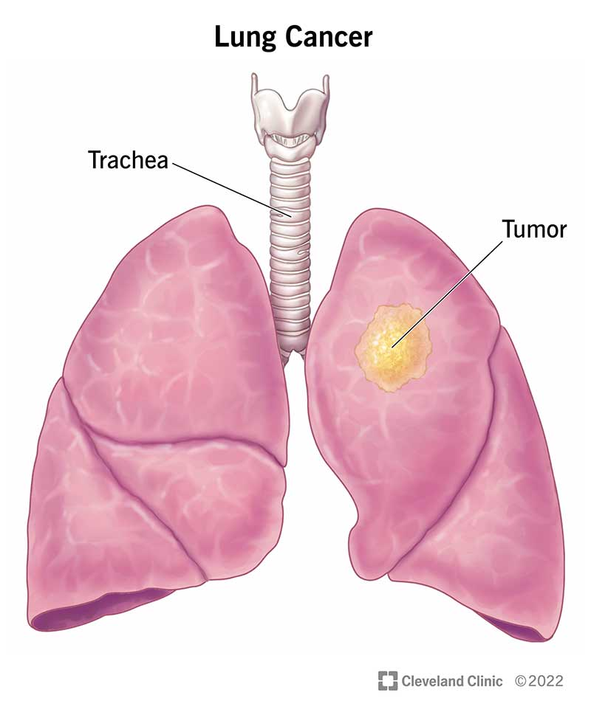
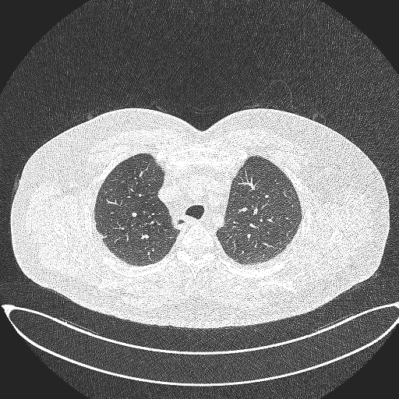
INTRODUCTION
Objective: The goal of this project is to reduce the time and effort required for lung cancer diagnosis, while also minimizing the possibility of human errors.
Motivation: The current standard method of diagnosing lung cancer is a time-consuming and error-prone process that requires doctors to visually examine CT scan images for small nodules and then classify them as benign or malignant. The proposed project aims to develop an AI-based solution that can accurately and efficiently inspect CT images and classify them in a matter of minutes.
Dataset: NCCD Lung cancer dataset was provided by Kaggle
Modules: tensorflow, keras, sklearn, imblearn

Slide 5
REVIEW OF DATASET

Slide 6
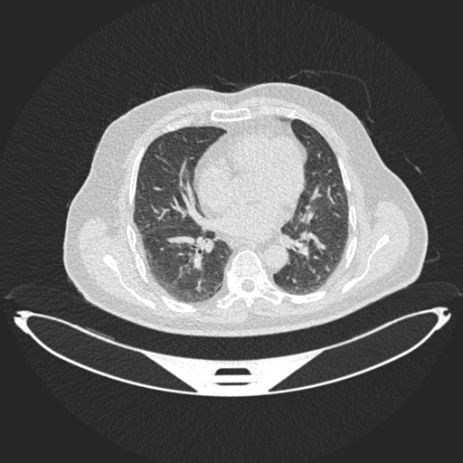
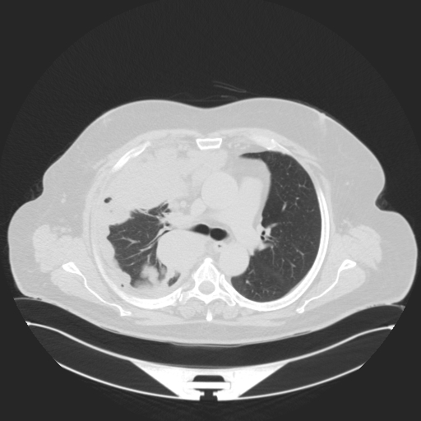
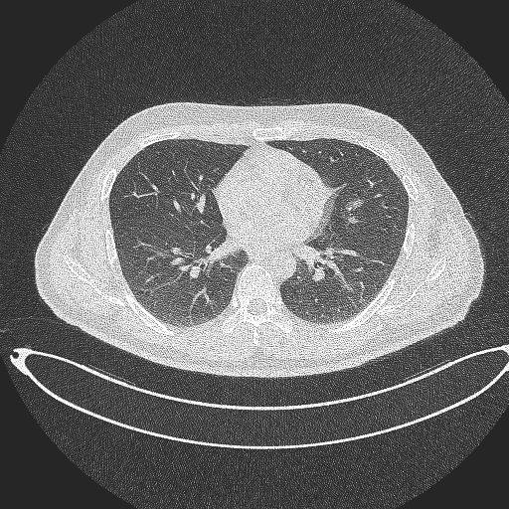
REVIEW OF DATASET
We have a dataset of 1190 CT scan images that represent 110 cases. The cases are classified into three categories, normal, benign, and malignant. Among the cases, 40 are diagnosed as malignant, 15 as benign, and 55 as normal.
These images will be used to train and test the deep learning model to classify new CT scan images based on the presence or absence of cancerous nodules.
Benign case
Malignant case
Normal case

Slide 7
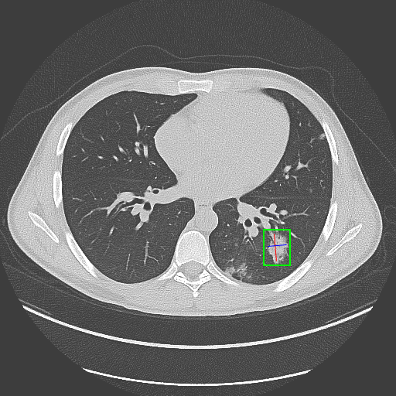
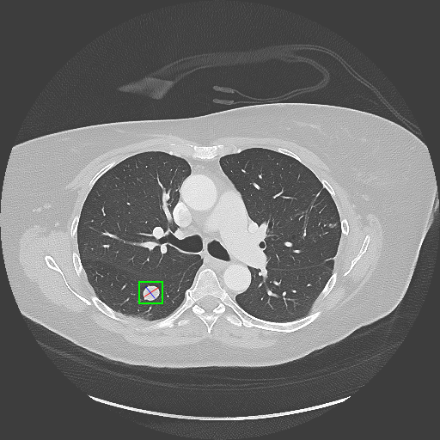
REVIEW OF DATASET
Each scan contains several slices. The number of these slices range from 80 to 200 slices, each of them represents an image of the human chest with different sides and angles.
The 110 cases vary in gender, age, educational attainment, area of residence, and living status.
Test cases of lung cancer of patients

Slide 8
OVERVIEW OF NEURAL NETWORKS

Slide 9
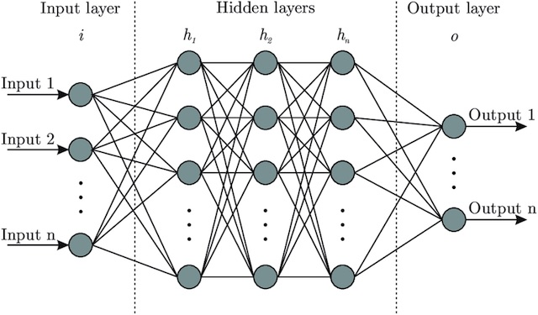
OVERVIEW OF NEURAL NETWORKS
Neural Networks consist of interconnected units called neurons, similar to synapses in the brain, which can transmit signals to other neurons. This interconnected nature allows them to learn and make decisions in a manner that resembles human thinking.
Deep Learning is a form of machine learning that replicates how humans acquire specific forms of knowledge. Unlike linear traditional algorithms, Deep Learning models, typically Neural Networks, are organized in a hierarchy where complexity and abstraction increase, hence the term "deep" in Deep Learning.

Slide 10
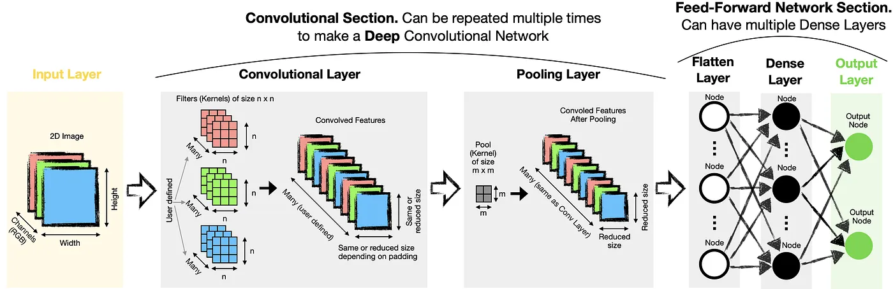
CONVOLUTIONAL NEURAL NETWORKS (CNN)
CNNs, or convolutional neural networks, are deep learning algorithms specifically designed for image and video analysis tasks.
They excel at automatically learning and extracting meaningful features from raw image data, enabling accurate image recognition, object detection, and segmentation.

Slide 11
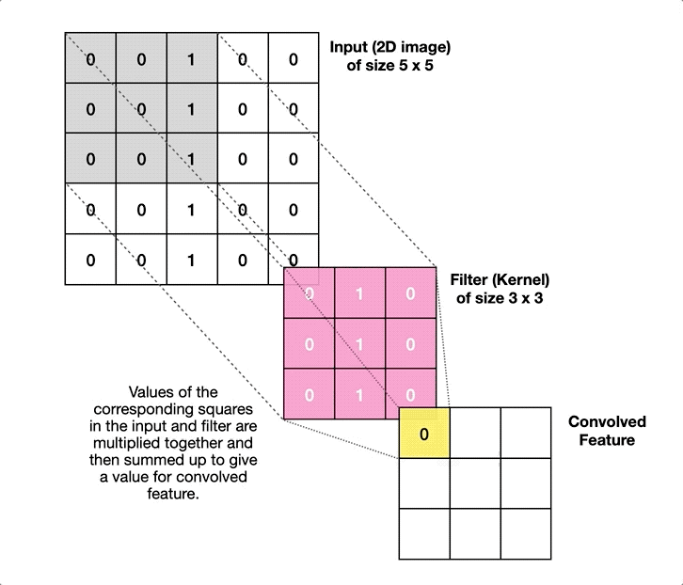
HOW DOES CONVOLUTION WORK?
There are three parts to a convolution: Input (e.g., 2D image), a filter (a.k.a. kernel) and an output (a.k.a. convolved feature).
During the convolution process in a CNN, a filter is repeatedly applied to sections of an input image. The filter calculates an output value for each section, and then it is shifted by a fixed amount, determined by the stride parameter, to continue the process until the entire image is convolved.
Stride refers to the shifting distance of a filter during the convolution process. When dealing with larger images, using larger strides can be beneficial as it reduces the output size. However, it is important to note that using larger strides may lead to the omission of certain features.

Slide 12
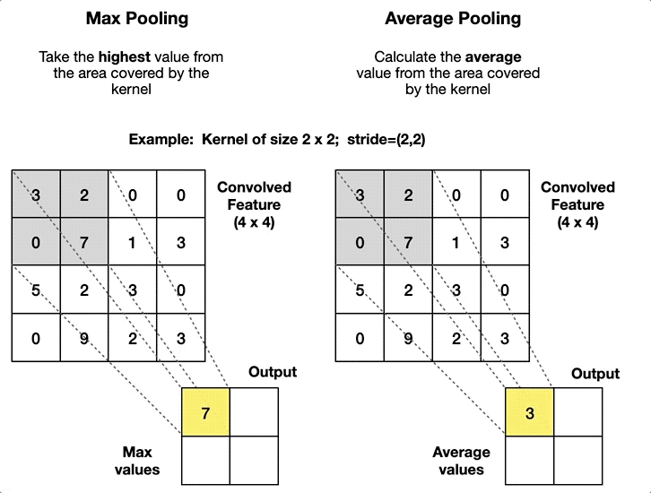
POOLING LAYER
Adding a Pooling layer after a Convolutional layer is a common practice. The primary objective is to enhance computational efficiency by reducing the size of Convolved Features. Additionally, the Pooling layer can contribute to noise reduction by retaining the most prominent activations in the data.
Once we have finished deriving Convolved Features, we need to flatten them. This enables us to have a one-dimensional input vector and utilise a traditional Feed-Froward Network architecture.

Slide 13
DATA PREPARATION - SMOTE

Slide 14
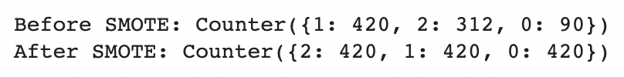
DATA PREPARATION - SMOTE
To tackle imbalanced datasets, one method is to address the minority class through oversampling. The straightforward approach involves duplicating instances from the minority class, which doesn't introduce new information to the model. Alternatively, a data augmentation technique called Synthetic Minority Oversampling Technique (SMOTE) can be employed to generate synthetic examples based on existing ones from the minority class.
Specifically, a random example from the minority class is first chosen. Then k of the nearest neighbors for that example are found (typically k=5). A randomly selected neighbor is chosen, and a synthetic example is created at a randomly selected point between the two examples in feature space.
Balancing to the number of malignant images

Slide 15
IMAGE PRE-PROCESSING

Slide 16
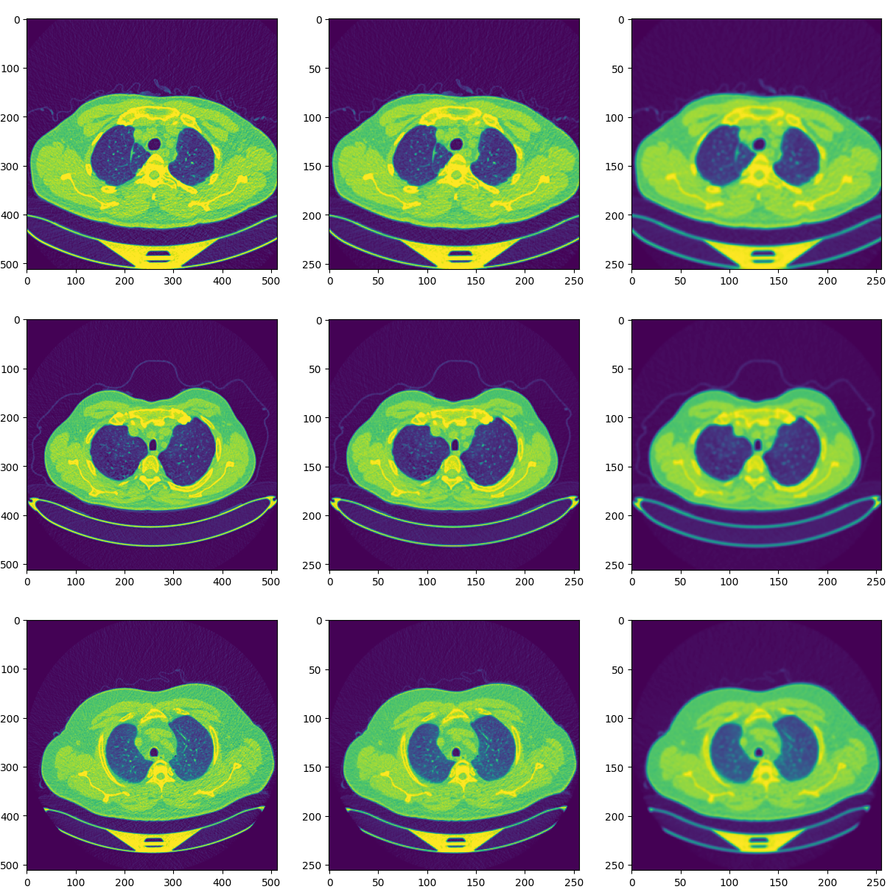
IMAGE PRE-PROCESSING
Reshaping
The images in this dataset had varying sizes, and thus required us to resize the images in order to have a balanced dataset
This was done with the help of resize function, and the images were adjusted to 256x256 pixels each
Gaussian Blur
Gaussian Blur is done in order to smoothen the images
This method gets rid of the noise, by applying a Gaussian Filter, essentially calculating a weighted average of nearby pixels, defined by the kernel size
These weights are assigned in accordance to a Gaussian Curve which gives more weight to the closer ones and less weight to the ones far away
Also a low-pass filter
Benign cases

Slide 17
CNN MODELS

Slide 18
Variables
Before Modeling it is necessary to understand the variables or hyperparameters one can alter while modeling, affecting the overall performance of a model in terms of accuracy or time taken to build
Number of Layers
As described before, a typical CNN Model consists of multiple layers, and can be altered depending on the complexity of the dataset.
Each Convolution Layer is followed by a Pooling Layer, which not only reduces the dimensionality, but also retains the important features before passing it onto the Activation Layer
The above-mentioned layers can be added repeatedly until the desired output is achieved, based on the desired level of accuracy or complexity.
Batch Size
It is not feasible to use the entire dataset at once, so, it is usually divided into various batches, where the batch size determines how many inputs will be considered during each iteration
A larger batch size can be computationally intensive, but more accurate and vice versa
Epochs
The number of epochs usually describes the number of times the model iterates through the dataset
A higher number of epochs can lead to overfitting
Thus, we have set models varying the above parameters, before settling on the best one

Slide 19
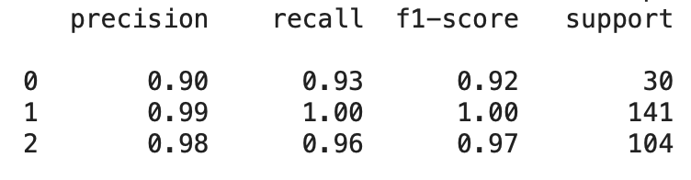
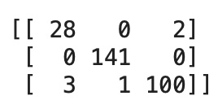
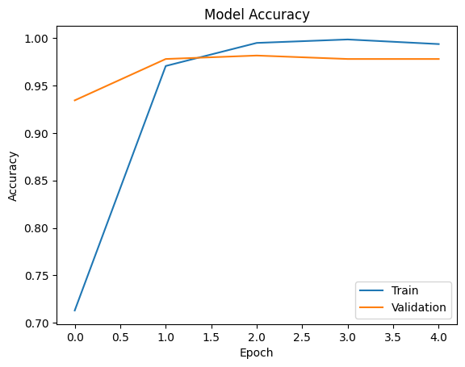
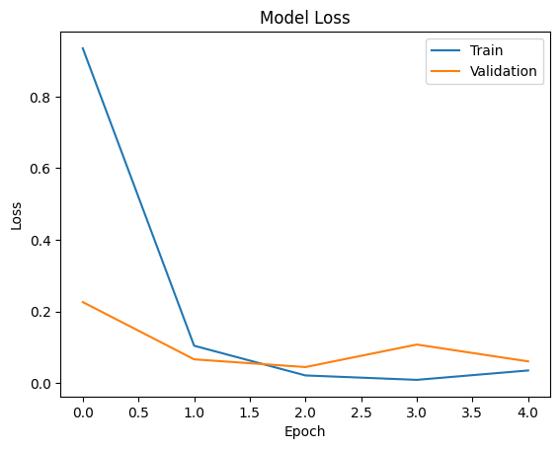
Imbalanced Model
We first begin with the Imbalanced Class as the Baseline Model and fit a CNN Model
The batch size was 8, with 5 total epochs
Output obtained as follows:
Here, we notice that the Model was able to classify the images with good enough power, but misclassified 4 instances of Class 2 or “Normal” and 2 instances of Class 1 or Benign.
Results per Class
Confusion Matrix
Accuracy and Loss Plots

Slide 20
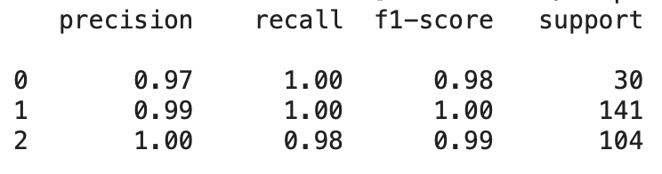
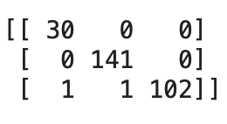
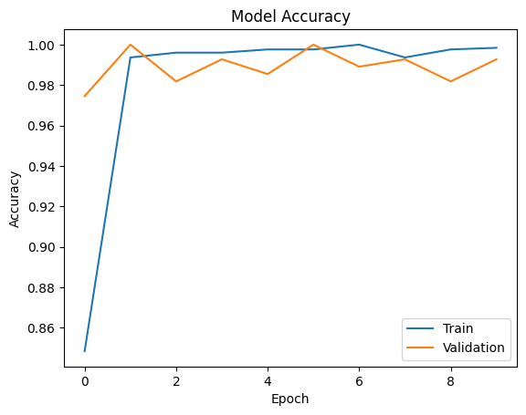
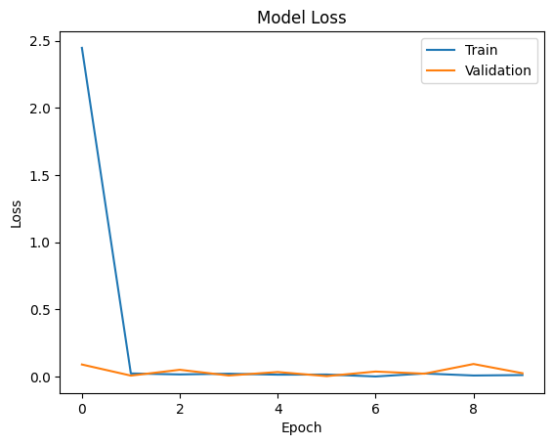
SMOTE Model – 1 Layer, Batch Size 8, Epochs 10
Here, we use the SMOTE Sampled data, to deal with Class Imbalance
The batch size was set to 8, with 10 total epochs and 1 Layer of Convolution
Output obtained as follows:
From the confusion matrix, we notice that we get 2 misclassifications for the Normal Case
Results per Class
Confusion Matrix
Accuracy and Loss Plots

Slide 21
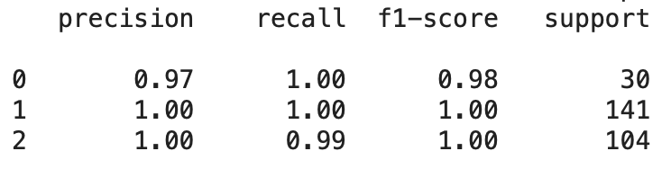
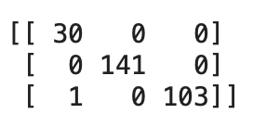
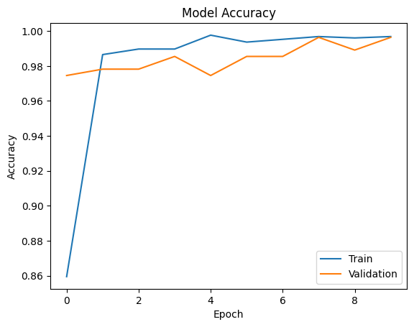
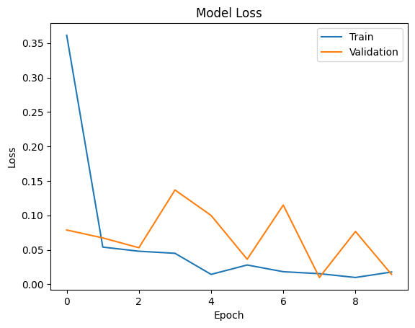
SMOTE Model- 2 Layers Batch Size 4, Epochs 10
As an improvement over the previous model, we now use 2 Layers
The batch size was set to 4, with 10 total epochs and 2 Layers of Convolution
Output obtained as follows:
Considerable improvement over the previous model, as there’s only a single instance of misclassification
Results per Class
Confusion Matrix
Accuracy and Loss Plots

Slide 22
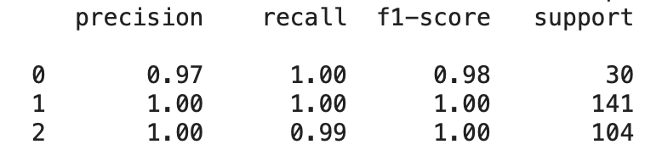
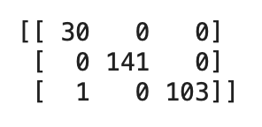
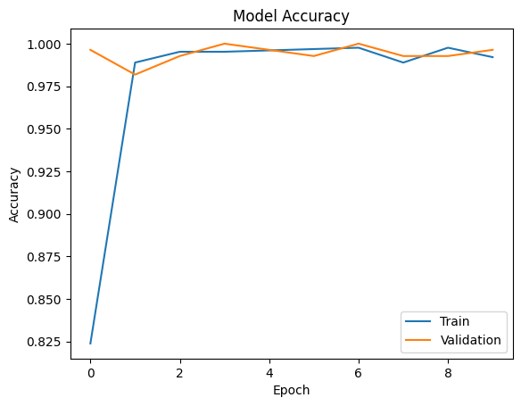
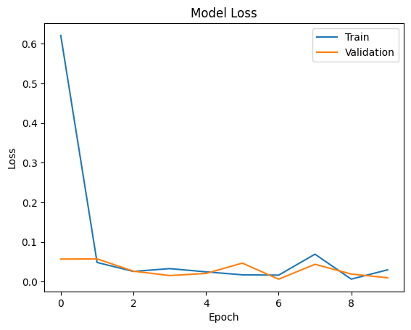
SMOTE Model - Batch Size 8, Epochs 10
In order to test the effect of Batch Size, we doubled the batch size and fitted the model again
The batch size was set to 8, with 10 total epochs and 2 Layers of Convolution
Output obtained as follows:
From the confusion matrix, we notice that we get one misclassification for a Normal Case
Results per Class
Confusion Matrix
Accuracy and Loss Plots

Slide 23
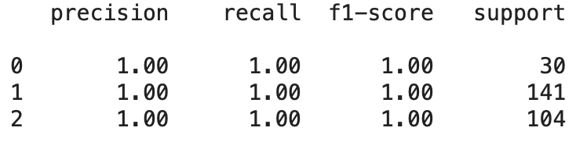
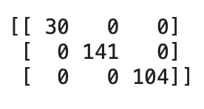
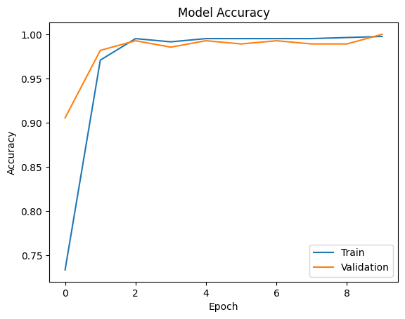
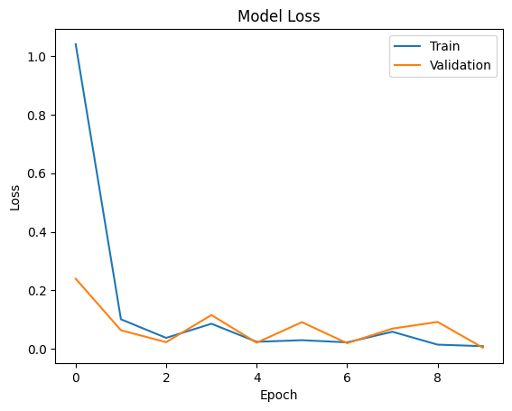
Class Weighted Approach
As an alternative to SMOTE, we use Class Weighted Approach, wherein instead of synthesizing new data, we use class weights in order to make up for the Class Imbalance
The batch size was set to 8, with 10 total epochs and 2 Layers of Convolution
Output obtained as follows:
Faster than the other methods, and the most accurate
Results per Class
Confusion Matrix
{0: 3.0814814814814815, 1: 0.6556343577620173, 2: 0.8693834900731452}
Class Weights
Accuracy and Loss Plots

Slide 24
COMPARISON OF RESULTS

Slide 25
Results
Model | Avg. Precision | Avg. Recall | Avg. F1 Score | Avg. Accuracy
Imbalanced | 95.67% | 96.33% | 96.33% | 97.82%
SMOTE- 1 Conv | 98.67% | 99.33% | 99% | 99.27%
SMOTE- 2 Conv, BS 4 | 99% | 99.67% | 99.33% | 99.64%
SMOTE- 2 Conv, BS 8 | 99% | 99.67% | 99.33% | 99.64%
Class Weighted Approach | 100% | 100% | 100% | 100%

Slide 26
CONCLUSION & FUTURE SCOPE

Slide 27
Conclusion
Since the Class weighted approach takes into account the imbalanced data and is giving an average recall of 100% for benign, malignant and normal cases, we can tell that this model would be a good approach for lung cancer diagnosis.
On the other hand, the above results could be circumstantial. It depends on how randomly the train and test split occurred, how the CT images were taken, what is the imbalance rate, how many layers were chosen, whether all the layers are able to capture different characteristics of the images etc. Therefore, a better model would be the one with SMOTE incorporated and 2 convolution layers with batch-size of 8.
Future Scope
Different angles to have a better picture of the entire lungs
Determining stage and the condition of tumor
Prediction/ Prescription of Treatment based on the tumor identified

Slide 28
THANK YOU

